Slide 1


SMART INDIA HACKATHON 2026
TITLE PAGE
• Problem Statement ID – 26183
• Problem Statement Title – Real-Time Identification of Fraud-Linked Cryptocurrency Exchanges from Victim-Reported Suspect Wallet Addresses through Automated Blockchain Analytics
• Theme – Blockchain & Cybersecurity
• PS Category – Software
• Team ID – BC-07
• Team Name (Registered on portal) – FineX
1

Slide 2
Finex.
PROPOSED SOLUTION
THE PROBLEM A victim reports one wallet. The money has already moved through several more, and the exchange that received it — the only party who can freeze it — is not named anywhere on the chain.
Manual tracing takes hours per case, and the freeze window is shorter than that.
OUR SOLUTION
FineX turns a victim-reported wallet — or the transaction hash their own exchange can produce — into the customer deposit account inside the receiving exchange, and states whether the money can still be reached.
WHAT AN OFFICER PUTS IN
A wallet address, a transaction hash, or a pasted column of either — singly or in bulk.
WHAT COMES BACK
A named exit account · a disposition · ranked next wallets · an evidence packet · a freeze request.
▪ It names the account, not just the exchange. The deposit address an exchange can actually restrain — 241 of them derived from public data alone.
▪ Triage, not just tracing. Every complaint returns CRITICAL (funds still at rest), SUSPICIOUS (a freezable exit named) or CLOSED (mixer or sanctioned), so a cyber cell knows where the next hour goes.
CRITICAL
Funds still at rest — act now
SUSPICIOUS
Freezable exit named — request the restraint
▪ Explainable by design. Six behavioural rules, each stating in plain words why it fired. No model names an exchange or sets a disposition.
CLOSED
Mixer or sanctioned — document and close
▪ Complaints that share an account are one case. Three of our ten recorded cases meet at a single MEXC deposit address.
Working deployment, not a mock-up — every figure on these slides is counted from the committed repository.
▪ Evidence, not a screenshot. Each case produces a packet carrying the SHA-256 of every blockchain response, plus a drafted restraint request.
@SIH Idea submission- Template 2
2

Slide 3
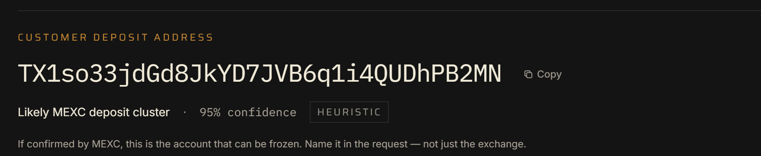
Finex.
TECHNICAL APPROACH
TECHNOLOGIES USED
PIPELINE — AND THE LIMITS IT RUNS UNDER
▪ Next.js 16.3.4 · React 19.2.8 · TypeScript 5
interface and API in one deployable
1 Intake Wallet or 64-hex transaction hash · base58check validated before any chain read
2 Collection Paginated TRC-20 transfers · per-address cache · shared adaptive pacing (250 ms, 100 ms keyed)
▪ Tailwind CSS 4 · Node.js 22
no component library, no build sprawl
3 Traversal BFS: depth ≤ 3 · top 5 outflows per wallet · drop < 1% of the amount · only what left after the money arrived
▪ TronGrid public API, native fetch
TRON mainnet, USDT TRC-20
4 Taint Haircut (default) and FIFO, stated side by side · dwell measured from a real receipt
▪ JSON datasets in the repository
no database to provision or lose
5 Attribution Deterministic lookup, priority sanctioned → hot wallet → deposit address · confidence + source tier on every label
6 Clustering ≥ 2 sweeps into one tagged wallet and ≥ 90% of inflow forwarded ⇒ customer deposit address (241 · 10 exchanges · 15 seeds)
▪ Rule-based scoring
no ML model, no language model, anywhere
7 Scoring SHORT_DWELL · HIGH_FANOUT · PEEL_CHAIN · ROUND_AMOUNTS · NEW_ADDRESS · SANCTIONED_CONTACT
▪ SHA-256 chain-of-custody
every chain response hashed into the packet
8 Triage CRITICAL / SUSPICIOUS / CLOSED with a one-sentence reason, plus ranked leads and chokepoints
9 Output Evidence packet (hash per response) · freeze request · CSV worklist · watchlist
ONE ADDED DEPENDENCY
@xyflow/react for the flow canvas. Every other visual is hand-drawn SVG.
Progress is streamed per hop as the trace runs, so the officer watches real telemetry — not a fake progress bar.
FROM THE LIVE DEPLOYMENT — the named customer deposit address, its confidence and its evidence tier
@SIH Idea submission- Template 3
3

Slide 4
Finex.
FEASIBILITY AND VIABILITY
EVERY RISK, PAIRED WITH WHAT WE ACTUALLY DO ABOUT IT
RISK Public API rate limits
MITIGATION One shared adaptive pacer for the whole server — 250 ms between calls, 100 ms with a key, doubling on every refusal. A wallet we could not read is reported as unreadable, never as empty.
RISK Mixers and bridges end the trail
MITIGATION We record the entry and stop. The case closes as CLOSED. We never guess past a bridge.
RISK Attribution is a heuristic, not proof
MITIGATION Every label carries a confidence and an evidence tier. Re-tested against the chain: 40 sampled, 31 readable, all 31 still meet the rule. Only the exchange can confirm the accountholder — the packet says so.
RISK Some behavioural rules are weak
MITIGATION Measured, not assumed: on a sample of 17 unreported wallets, peel-chain fired on 16 and fan-out on 15, so both are known to be weak on their own.
RISK No Indian VASP is publicly tagged
MITIGATION 2,500 tagged accounts scanned and none found. We do not invent one; adding a verified Indian exchange is one row of data and one re-run of the clustering.
RISK Cost, deployment and data custody
MITIGATION Public endpoints, no licence, no database. Self-hosted by the agency, so case data never leaves it. ₹0 in data licences as deployed.
@SIH Idea submission- Template 4
4

Slide 5
Finex.
IMPACT AND BENEFITS
MEASURED, FROM THE COMMITTED REPOSITORY
241
customer deposit
addresses derived
10
exchanges covered,
from 15 public seeds
202
OFAC-sanctioned
TRON addresses
6 / 6
behavioural rules fire
on real recorded cases
33 / 0
transactions confirmed
on re-read / mismatched
₹0
in commercial
data licences
WHAT IT CHANGES
AGAINST THE PROBLEM STATEMENT
▪ For the investigator. A named account to act on and a disposition that says which case is worth the next hour.
BUILT NOW
VASP identification · wallet tracing · real-time analysis · fund-flow visualisation · exchange clustering · pattern detection · standard reports · investigative recommendations · dashboards · complaint intake · API integrations · wallet risk categorisation · automated alerts
▪ For the exchange. A restraint request that names the deposit address, not just the brand — the account they can actually locate.
AT THE FINALE
Cross-chain adapter with USDT on Ethereum end to end · NCRP intake API returning a restraint request against an acknowledgement number · server-side continuous monitoring
▪ For the case file. Findings re-verifiable from the hash of every chain response, months later.
▪ For the state. Sovereign and self-hosted: public data only, no foreign vendor, no per-seat licence.
AFTER SIH
Live NCRP / SAHYOG connection once I4C grants access · self-hosted TRON node for indexing at scale · ML that ranks the queue only — never names an exchange or sets a disposition
Mixers: a path touching a sanctioned service closes the case. A dedicated mixer list is deliberately empty — no citable public source, and a wrong entry would close a case that should stay open.
@SIH Idea submission- Template 5
5

Slide 6
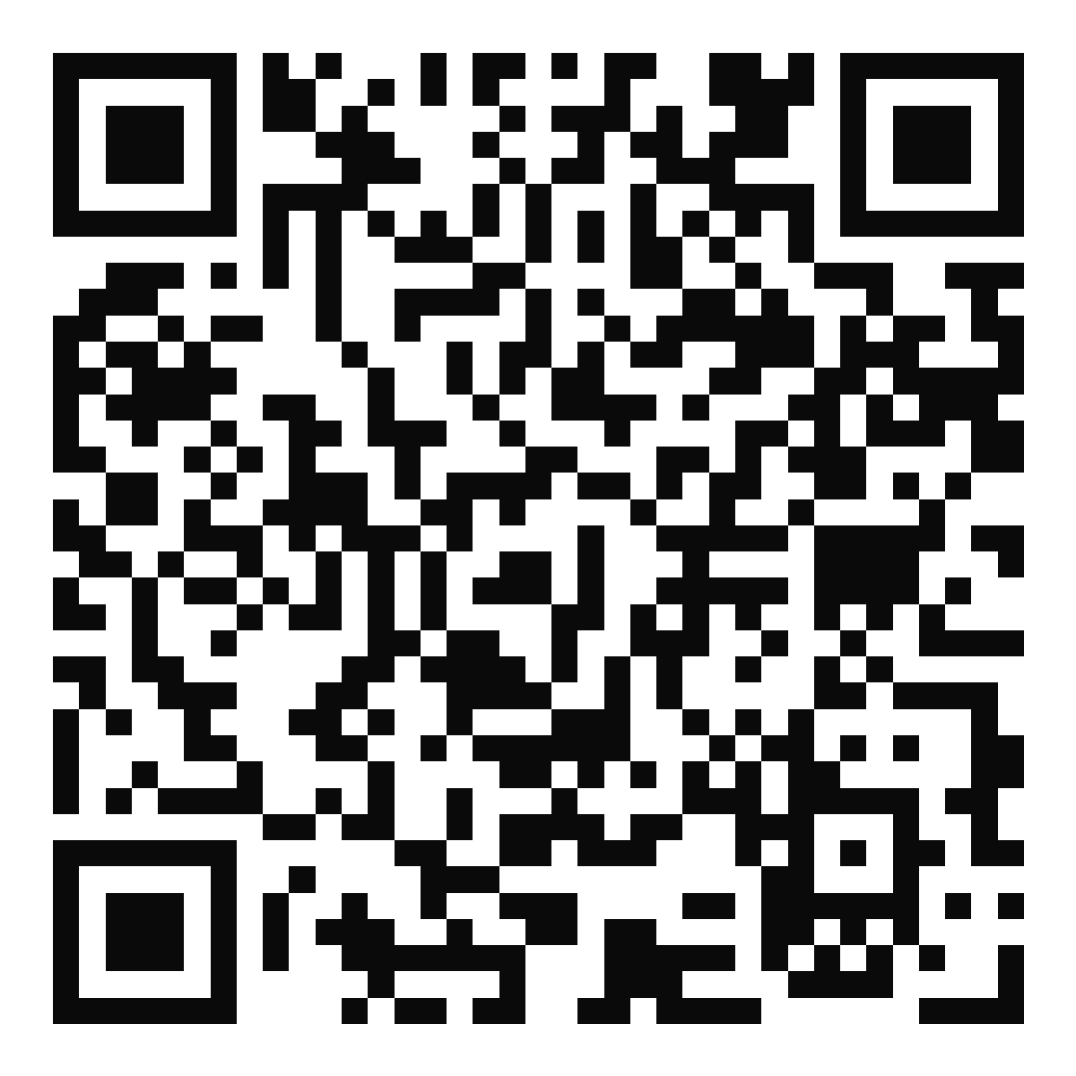

Finex.
RESEARCH AND REFERENCES
1. Smart India Hackathon 2026 — Problem Statement SIH26183, Ministry of Home Affairs / I4C
https://www.sih.gov.in/sih2026PS
OPEN THE WORKING TOOL
2. UNODC (2024) — Casinos, Money Laundering, Underground Banking and Transnational Organized Crime in East and South-East Asia, p. 20: USDT on TRON “has become a preferred choice”. This is why the tool is TRON-first.
https://www.unodc.org/roseap/uploads/documents/Publications/2024/Casino_Underground_Banking_Report_2024.pdf
3. OFAC Specially Designated Nationals list, US Department of the Treasury — source of the 202 sanctioned TRON addresses carried in the tool
https://sanctionslist.ofac.treas.gov/Home/SdnList
4. TronGrid API documentation, TRON — TRC-20 transfer data used for every trace
https://developers.tron.network/reference/trongrid-v1-api-overview
crypto-fraud-tracer.onrender.com
Three recorded cases open straight from the front page.
5. NCRP and SAHYOG — the platforms the problem statement asks this system to integrate with
https://cybercrime.gov.in · https://sahyog.mha.gov.in
DEMO VIDEO — 58 SECONDS
A full case, start to finish, with narration.
Source code and documentation github.com/reemrasheed2007/crypto-fraud-tracer
Live deployment crypto-fraud-tracer.onrender.com
paste the video link here
KEY RESEARCH INSIGHT
Public blockchain data → traceable fund movement → a named account an exchange can freeze.
@SIH Idea submission- Template 6
6

